Slide 1
Insurance Policy Recommendation Engine

Slide 2
Key Takeaways
Problem: To build a system that recommends the best insurance policy based on customer attributes.
1
What was done: Data analysis and machine learning techniques were applied to identify key features and train models for accurate prediction.
2
Result: The Random Forest model was the best performing model with a final accuracy of 64.36%, after incorporating additional variables.
3

Slide 3
Process - EDA
The dataset consists of policyholder information from an insurance provider. It contains various demographic and financial attributes related to insurance product choices
1
Replaced missing values in PPC and Prosperity with mean values. Replacing missing values with the mean helps maintain the data's overall distribution and avoids skewing results, which could occur if zero were used.
2
Converted categorical variables (PH_OCC, PH_EDUCATION) into factors allows the model to recognize them as distinct categories rather than continuous numbers, improving predictions.
3
Removed top 1% outliers from PPC to ensure a balanced data set. By doing this, we ensure a more balanced dataset, reducing potential biases and improving overall model performance, particularly when dealing with highly skewed continuous variables like PPC.
4

Slide 4
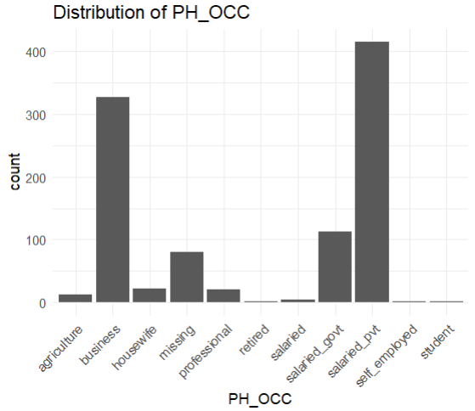
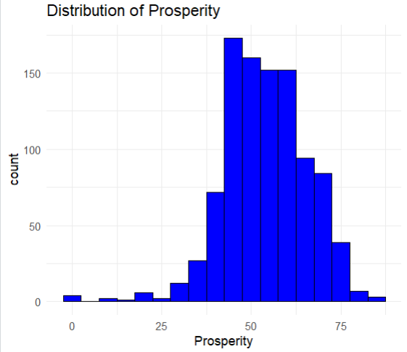
EDA – Discrete & Continuous Variables
Discrete Variables
Visualized the distribution of the policyholder's occupation across various categories.
Business and Self-employed are the dominant occupations among policyholders.
Smaller representation from occupations like agriculture, professional, and retired.
This variable helps identify which products are suitable based on the policyholder's profession.
Continuous Variables
Analyzed the Prosperity score, which reflects the financial well-being of the policyholder.
Prosperity distribution shows a normal-like distribution, centered around 50.
The majority of policyholders have prosperity scores between 40 and 60.
This variable is crucial in determining appropriate insurance products, especially those tied to financial stability.
Distribution of Discrete Variable
Distribution of Continuous Variable

Slide 5
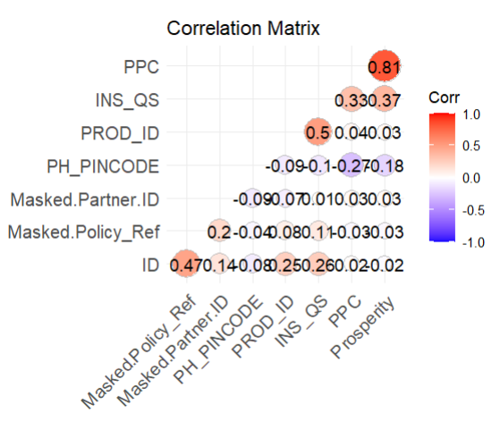
EDA – Correlation Matrix
The correlation matrix is used to identify relationships between key variables in the dataset.
PPC and Prosperity show a strong positive correlation (0.81), meaning they tend to increase together.
Moderate correlations are observed between other variables such as INS_QS and PPC (0.33).
This helps in understanding which factors have similar behavior and might affect model outcomes.
Although PPC and Prosperity are strongly correlated, this relationship might not significantly enhance the model's predictive power. Further exploration is needed to assess their individual impact on recommendations.
Correlation Matrix

Slide 6
Exploring Models: Collaborative Filtering vs Classification
Considered both Collaborative Filtering (recommendation) and classification models.
Collaborative Filtering faced issues due to sparse data and lack of frequent user-policy interactions. Each user had only one policy interaction, which made it difficult to identify patterns or similarities across different users.
This lack of multiple interactions per user prevented the model from building meaningful recommendations.
The data structure was not well-suited for building a strong interaction matrix required for recommendation systems.
Classification models, such as Random Forest and Decision Trees, performed better as they leveraged well-defined features like occupation, education, and prosperity.
The structured nature of the dataset made classification a better fit for accurate predictions.
Overall, classification models were more effective in handling this data compared to recommendation-based approaches.

Slide 7
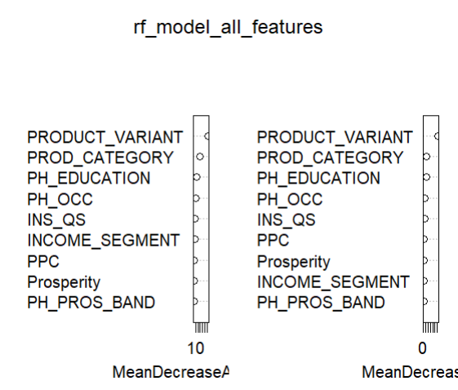
Feature Importance and Selection
All Features
Analyzed feature importance using Random Forest to identify which features most influence the prediction.
Initially included features like PRODUCT_VARIANT, PROD_CATEGORY, PH_EDUCATION, PH_OCC, INS_QS, PPC, and Prosperity.
Feature Importance Plot:
The left plot shows the mean decease in accuracy. This indicates how much accuracy decreases when a particular feature is left out of the model. Higher values mean the feature is more important for accurate predictions.
The right plot shows Mean Decrease in Gini. This measures the purity of the splits created by each feature in the decision trees. A higher Mean Decrease in Gini indicates that a feature is very helpful in improving the decision-making of the model. Essentially, it shows which features are most important in helping the model correctly classify the data.
Higher values show that the feature is better at separating the classes, thus being more important.
All Features

Slide 8
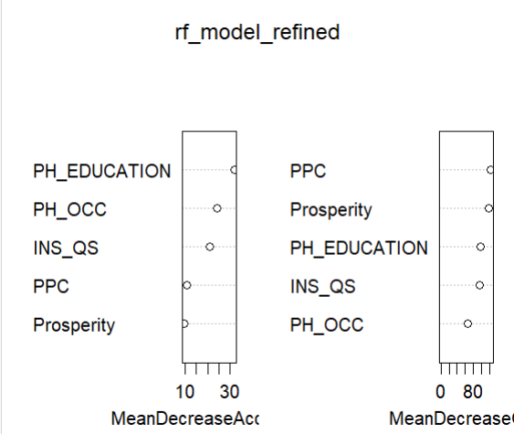
Feature Importance and Selection
Selected Features
The plots revealed that PH_EDUCATION, PH_OCC, INS_QS, PPC, and Prosperity were the most important features.
Less impactful features, such as PH_PROS_BAND and INCOME SEGMENT, were removed to create a refined model.
Reducing the model to the most important features improved efficiency and accuracy by reducing noise
All Features

Slide 9

Classification Model Accuracy Comparison
I trained three models: Random Forest, K-Nearest Neighbors (KNN), and Decision Tree.
Random Forest: I chose this because it combines multiple decision trees to improve prediction accuracy. It handles complex data well.
KNN: It works well with smaller datasets and is easy to understand. It can provide good results when the relationships between features are simple, making it worth testing.
Decision Tree: It's straightforward and interpretable, offering clear insights into how decisions are made. It can handle both categorical and numerical data effectively.
The key criterion for choosing the final model was accuracy.
Based on the accuracy results, I selected the Random Forest model as the best-performing model.
Accuracy of all three models

Slide 10

Improving the Random Forest Model
The initial Random Forest model achieved an accuracy of 57.76%.
To enhance the model, I performed hyperparameter tuning to find the optimal settings for accuracy improvement.
Key hyperparameters such as the number of trees and features considered at each split were adjusted.
After model predictions, I grouped policies into broader product categories for better organization.
Instead of predicting the exact product, I focused on classifying policies into their respective categories.
This approach allowed the model to make broader, more accurate predictions at the category level.
By comparing predicted product categories with the actual test data, I was able to evaluate performance more effectively.
This adjustment led to a significant improvement, boosting the model’s accuracy to 64.36%.
Accuracy after improving the Random Forest Model

Slide 11
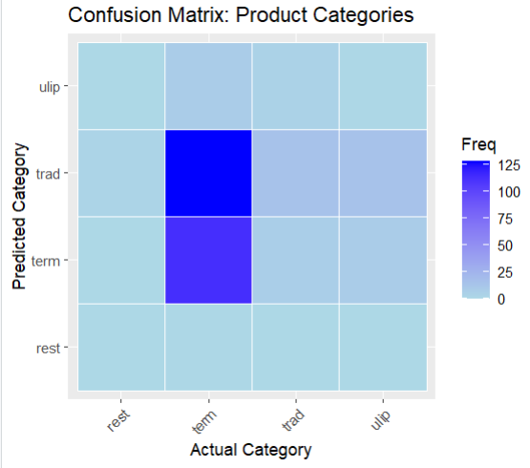
Final Random Forest Model
The y-axis represents the predicted product categories, and the x-axis represents the actual product categories from the test data.
The frequency (or count) of predictions for each category combination is color-coded from light blue (fewer predictions) to dark blue (more predictions).
Most predictions are concentrated in the “trad" category, indicating the model frequently predicts products to fall into that category, whether correctly or incorrectly.
The model appears to struggle with some categories like "ulip" and "rest," which have lower frequencies of correct predictions.
There's a noticeable bias toward predicting products as "term" products, which may need further refinement for balanced accuracy across all categories
Final Model Confusion Matric

Slide 12
Conclusion and Future work
1
Key Results:
The final model achieved an accuracy of 64.36% using product category categorization, significantly improved from earlier models
Model Effectiveness:
Random Forest was the most effective model, outperforming KNN and Decision Tree in accuracy for classifying insurance policies.
2
Future Improvements:
Further fine-tune hyperparameters like mtry and ntree. Explore better categorization techniques or advanced models for improved accuracy.
3

Slide 13
THANK YOU

